Slide 1


Slide 2
D365FO, OData and Custom Apps: High Performance Integration Scenarios

Slide 3

Nathan Clouse
Microsoft Business Applications MVP
Technical Architect enVista Corp.
Microsoft Business Applications MVP nclouse@envistacorp.com www.atomicax.com
@NathanClouseAX

Slide 4
Topics
Memes
Audience
Define Problems
Performance
Workloads
What is OData a good tool for?
CRUD
What is OData not a good tool for?
Everything else
Other considerations
OData Data entities
Read Performance
Data entity complexity
Multi-threading
EXPAND()?
Insert
Update
Delete

Slide 5
Sources
https://github.com/NathanClouseAX/AAXDataEntityPerfTest
http://www.atomicax.com/content/odata-experiment-deep-dive-odata-and-how-use-it
https://github.com/NathanClouseAX/AAXDataEntities
https://github.com/users/NathanClouseAX/projects/2

Slide 6
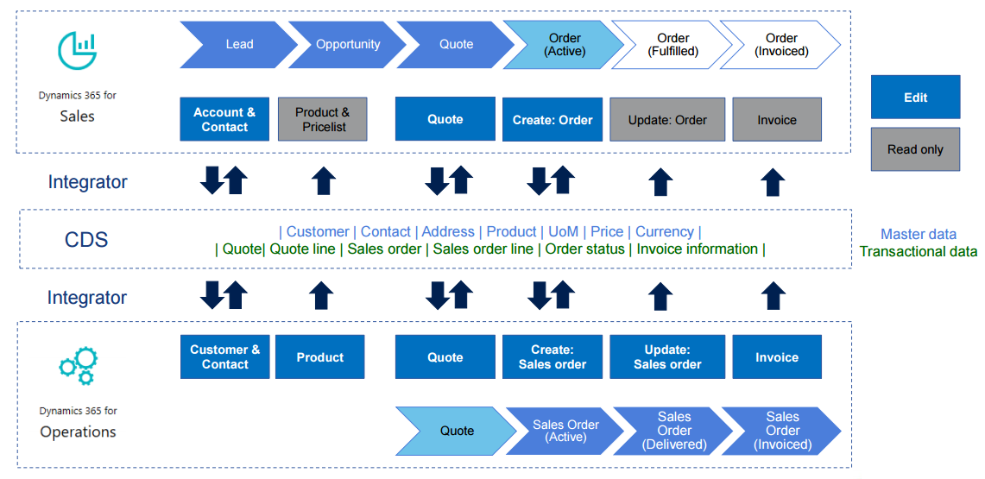
Performance
What is your required level of performance?
What is acceptable?
What is not?
Is this workload dependent?
What processes have specific SLAs?
Are those SLA’s known and declared?
Anything else that needs to be called out?
How are we going to use OData?
Diagram of infrastructure

Slide 7
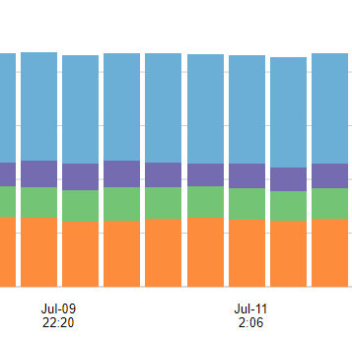
Workloads
Specialized workflow for a module to support the business?
Portal for customers or vendors to view data?
Workspace for vendors or customers to enter orders, update statuses, etc.

Slide 8

Primary Success Factors
Questions that need answers
Get x in less than y milliseconds?
Update x in less than y ms?
Insert x in less than y ms?
Delete x in less than y ms
But WHY?

Slide 9
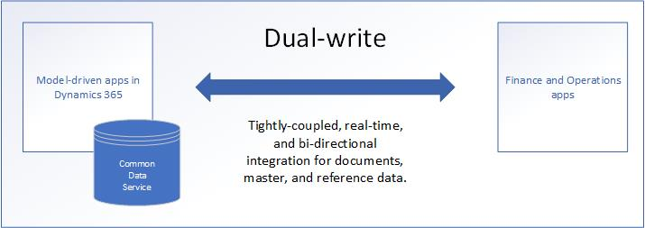
What About Dual-Write?
Synchronous and bidirectional data flow between applications
Synchronization with online and offline/asynchronous modes.
Ability to sync initial data between the applications
Out-of-box setup experience for new customers
Dataverse

Slide 10

What is OData A Good Tool For?
CRUD operations on declared data entities
Includes customizations if new fields added to entities
Postings not generally supported such as posting a sales order invoice
Think “spreadsheet” or “List Management”
Used by the Excel Add-in

Slide 11
What is OData NOT A Good Tool For?
Data extraction in bulk
use the DMF with BYOD
export to data lake (when available)
Posting transactions
use a custom service
Managing data using the Power Platform
Use Dual Write
Extracting data on a schedule
Use recurring integration framework
Use batch data framework
React to something happening or changing
Use business events
Use Power Automate

Slide 12

Other Considerations
In Development / T1, all parts of the app are in the same place (SQL, IIS, MR, Batch, everything else)
F&O
SQL

Slide 13
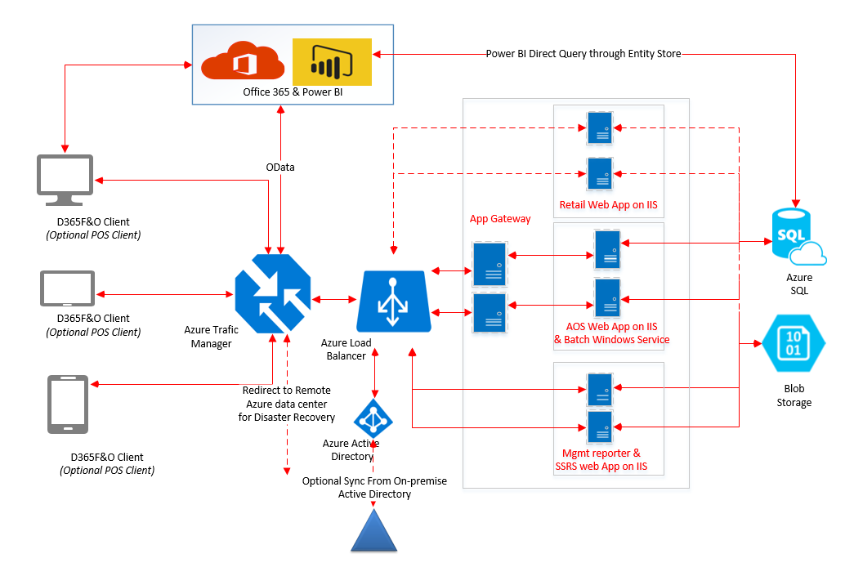
Other Considerations (cont.)
In UAT or greater / T2, all parts of the app could be or are known to be in different places, so network lag becomes a consideration
SQL
F&O

Slide 14

Data Entities Vs OData Data Entities
Little difference
Set “public” to yes
Very similar
OData enabled entities require a little more code
Optimized for OData usage
Enforce more business rules and logic
Tests should include DMF, x++ and C# (or similar) testing
Confirm all entry points give the same result

Slide 15

Read Performance
Biggest, most visible area for performance
(probably) the bulk of the workload for a given integration
Have to scope before you can update or delete
Customer Portal: get list of orders, select one from a list, get the details for that order, review extended details (pick list, pack slip, invoice, etc)
Customer Workspace: User get’s a list of order, selects one from that list, gets details, makes changes, sends update

Slide 16
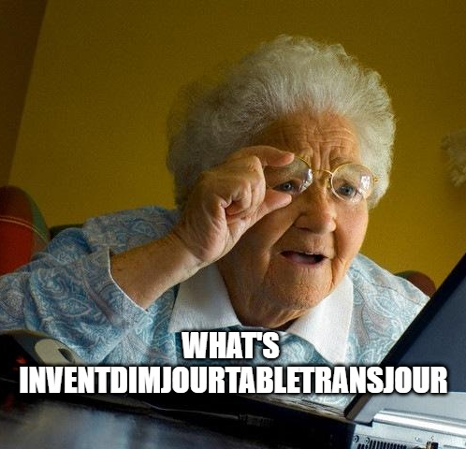
Read Performance – Data Entity Complexity
Fewer Columns = “faster”
Fewer table / joins = “faster”
ReadOnly attribute is for functionality, not performance
“faster” for 1 row means more faster for 10+ rows
Row vs Set behaves differently

Slide 17
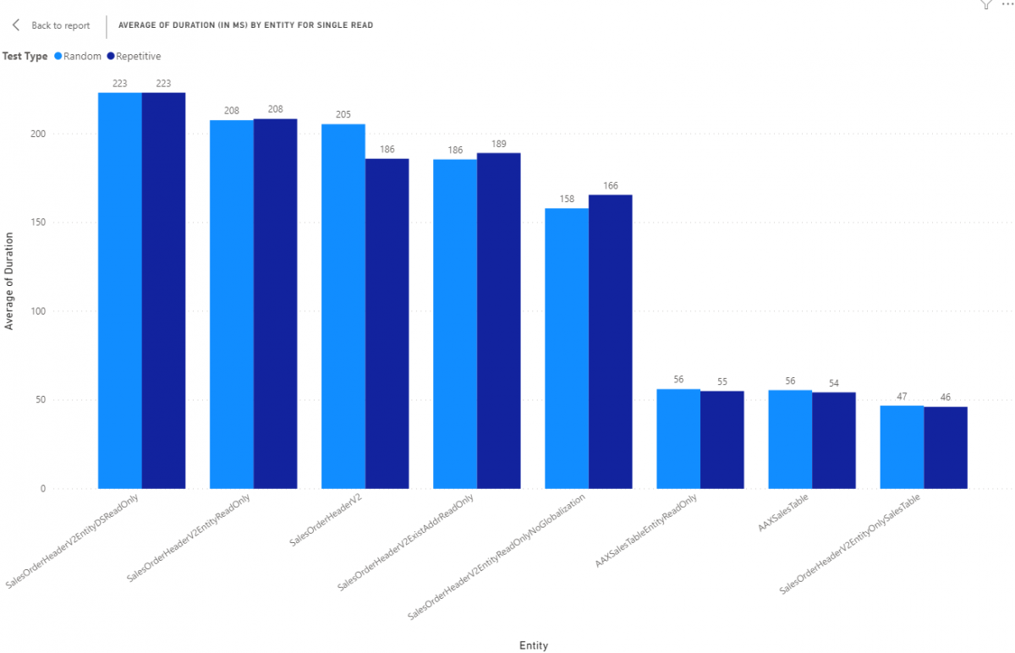
1
2
3
4
5
6
7
8
Notes:
Explain setup and tests, 100 random reads from data entities with different key characteristics to draw out beahviors
1 This is a copy of the standards entity with all data sources marked as being read only
2 This is a copy of the standard entity with the entire entity set to read only
3 OOTB entity
4 OOTB entity
5 This is a copy of the standard entity that is read only but also all data sources that were related to globalization have been removed such as SalesTable_W, SalesTable_BR, and BaseDocument_IT
6 This is an entity built on top of table SalesTable as a read only entity.
7 This is an entity built on top of table SalesTable only but it supports all CRUD operations but doesn't have any code in the entity
8 This is a copy of the standard entity with all data sources that weren't table SalesTable removed

Slide 18
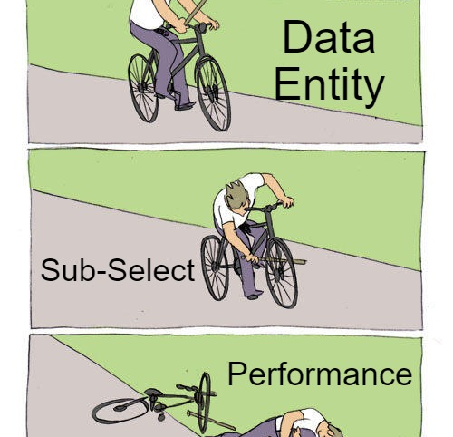
Read Performance – Data Entity Complexity
No sub-selects is ideal
Data entity gets boiled down to be a SQL view
Views can contain sub-selects to other data sources
Can ( and will ) kill performance

Slide 19
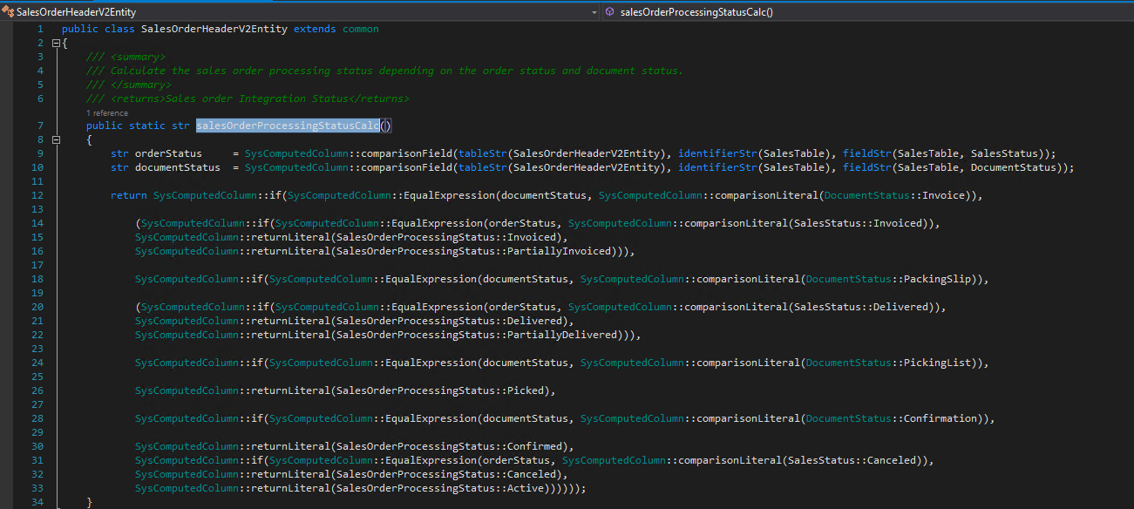

Slide 20
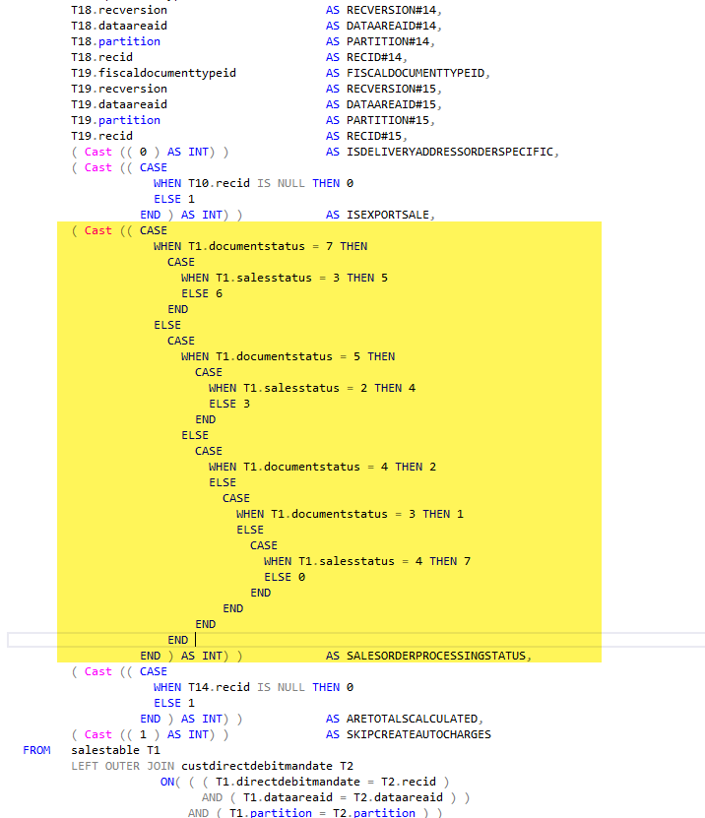

Slide 21
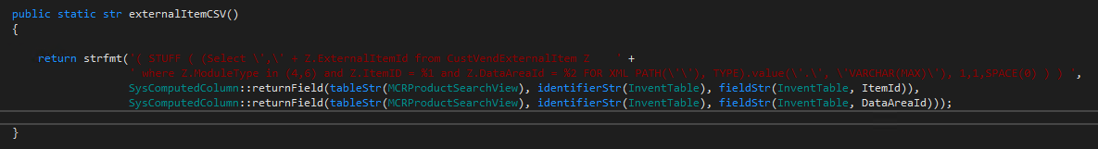
Notes:
Correlated subqueries should be used sparingly (i.e. when an inner condition refers to an outer clause).

Slide 22

Read Performance – Consumer Tricks
Using a SELECT() will provide some performance improvements when fetching more than 1 record
Using a SELECT() will provide some performance degradation when fetching just 1 record

Slide 23
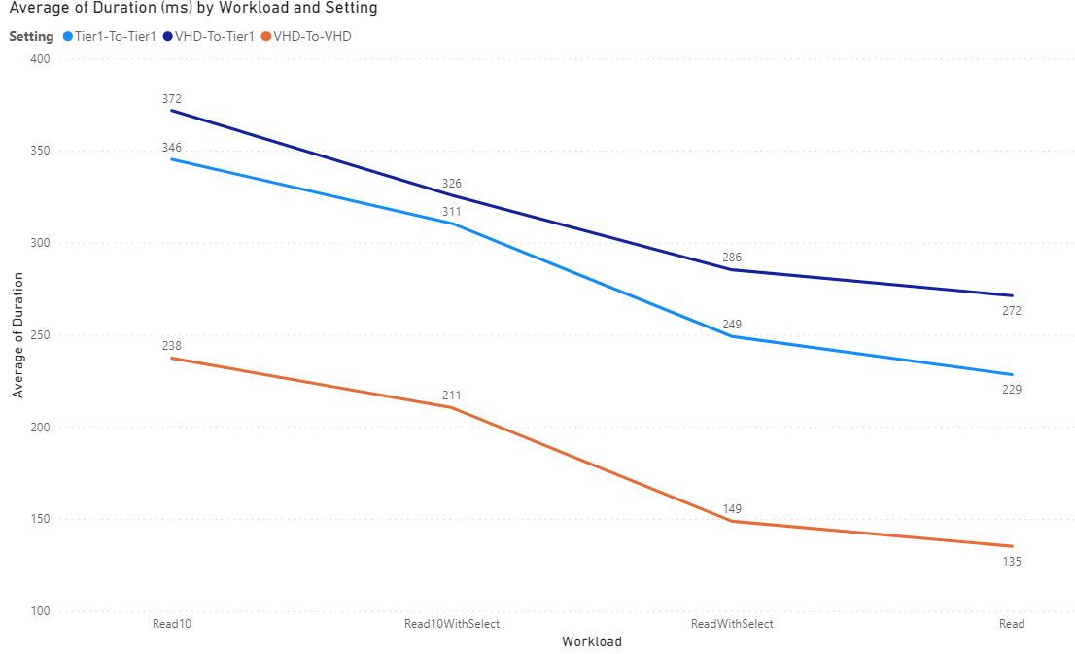
1
2
3
4
Notes:
Using SalesOrderHeaderV2 OOTB entity
1 reading 10 Sales Orders
2 reading 10 sales orders with a SELECT() on 5 fields – only getting 5 fields
3 Reading 1 record with SELECT() on 5 fields,
4 reading 1 record
Whats going on? SELECT() is an extra step, requires extra time
Net savings related to performance are related to having to package and send less to the requester
Also initial overhead for processing n records that is incurred regardless of what n is

Slide 24
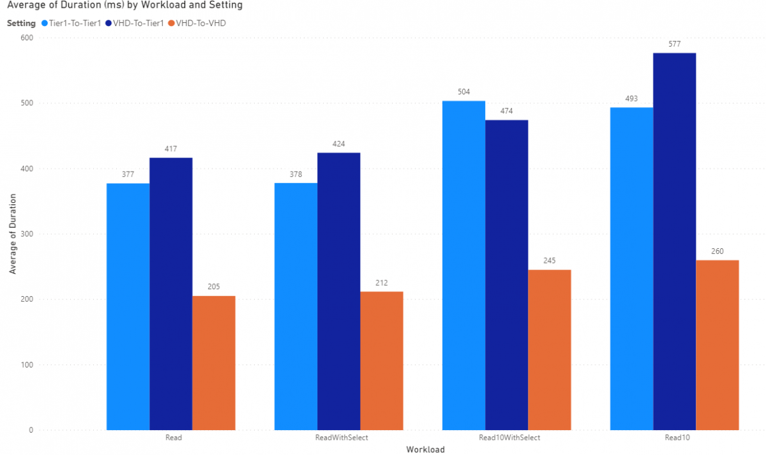
1
2
4
3
Notes:
Using SalesOrderHeaderV2Entity. It presents with 250 fields and again we're only selecting 5. Not much to remark on other than the introduction of the VHD-to-Tier1 did perform better than the simple Read 10 so we can see the advantage of a Select() when considering network latency. This was from a home interent connection to a VM hosted in Central US Azure.

Slide 25

Read Performance – Consumer Tricks, Part 2
Filter based on underlying data sources indexes
If a specific index isn't known, specify everything you can and let SQL pick an index for you
The better the index selection for a query, the faster the query is as well as being more reliable and predictable from a performance perspective

Slide 26
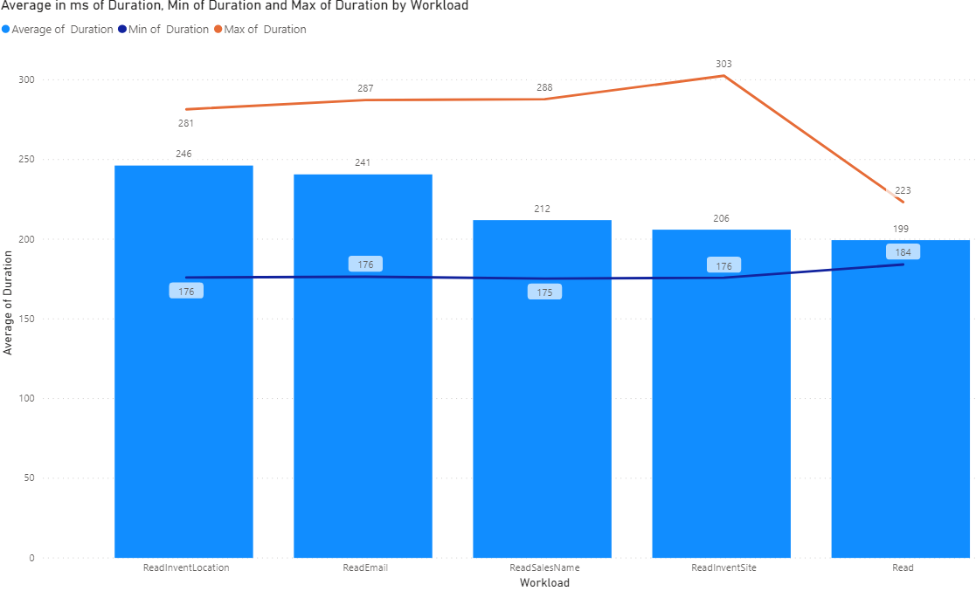
Notes:
Fetching 1 record by specific indexes on SalesOrderHeaderV2
Callout that sales order header v2 has range on SalesType = SalesOrder
No index on inventLocationId, email, salesname, or inventsite
Note that the best performing is just SalesId

Slide 27
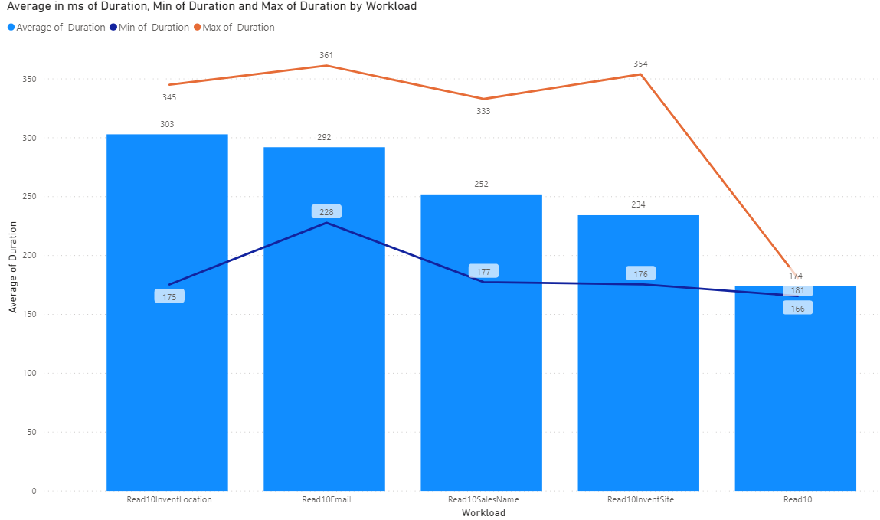
Notes:
Fetching 10 record by specific indexes on SalesOrderHeaderV2
Note that the best performing is just SalesId

Slide 28
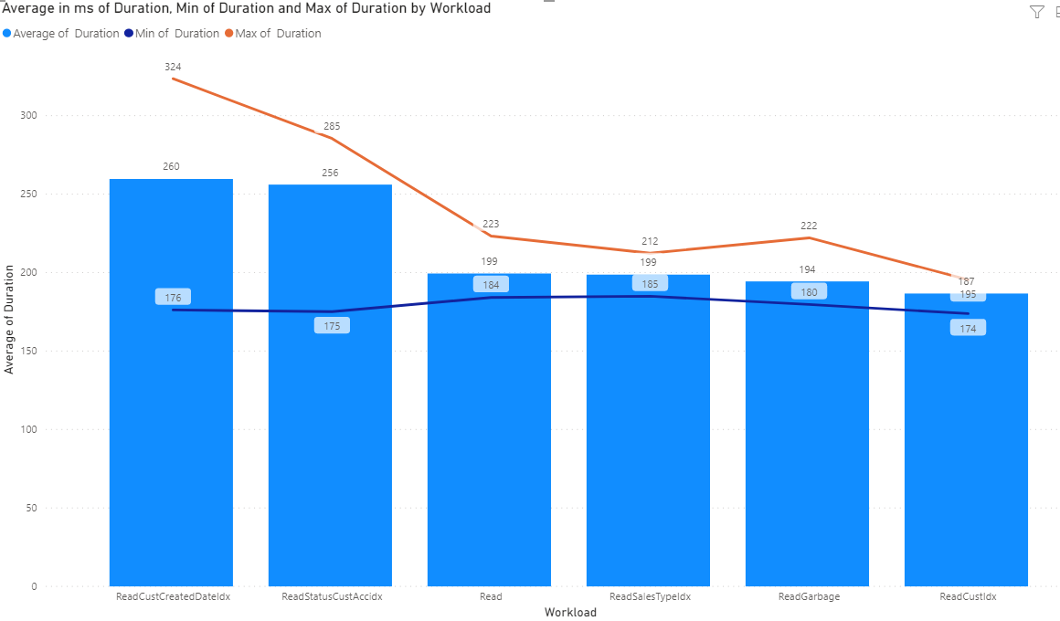
Notes:
ReadCustCreatedDateIdx - We fetched records specific on fields DataAreaId, CustAccount and CreatedDateTime 100 times. This ended up being our worst performing index despiate the DateTime being part of the index. This also had the most variability so I suggest not using a DateTime based index for lookups. This index is not unique.
ReadStatusCustAccIdx - We fetched records on fields DataAreaId, SalesStatus and CustAccount 100 times. This was marginally better than the CustCreditDateIdx. This index is not unique.
Read - We fetched records on DataAreaId and SalesId. This is a standard random read on a Sales Order header. This index is unique so that is why it is so much faster than the CustCreatedDateIdx and StatusCustAccIdx.
ReadSalesTypeIdx - We fetched records on DataAreaId, SalesType and SalesId. Similar to the "read" test, we're looking up against a unique index but this index, SalesTypeIdx, is a subset of SalesId Index so its slightly more specific so it was marginally faster in our tests.
ReadGarbage - This was the wildcard in the test as we aren't hitting any specific index by design. We did 100 lookups based on all columns in all indexes included in tests so far to see if SQL would pick and use the best index based on what we were looking up data on. The good news is that it did a fairly decent job of picking an index and returning the data in a fairly short amount of time. This approach, where we are specifying a WHERE with as much info as we have, seems to work just fine if we don't know of or have a specific index we want to lookup against.
ReadCustIdx - We fetched records on DataAreaId, CustAccount, SalesId and PurchOrderFormNum. This was our best performing lookup by index and reviewing the features of the index, it makes sense. This index, CustIdx, has CustAccount, SalesId and PurchOrderFormNum all together as a unique index. In terms of how SQL is looking at data it will do a "soft filter" based on CustAccount first then lookup SalesId then PurchOrderFormNum from that initial "soft filtered" list so it just ends up being faster because it uses parts of the WHERE to get rid of just to scan prior to doing any additional scans.

Slide 29
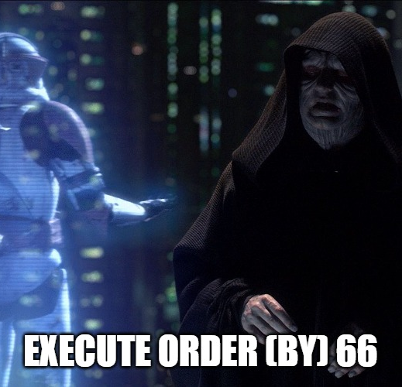
Read Performance – Consumer Tricks Part 3
Limit use of ORDER BY statements
ORDER BY on a specific index
Calculated fields / Sub-selects are marginally more performant than "normal" fields not in an index
May be based on limited dataset from Contoso
Test for your data

Slide 30
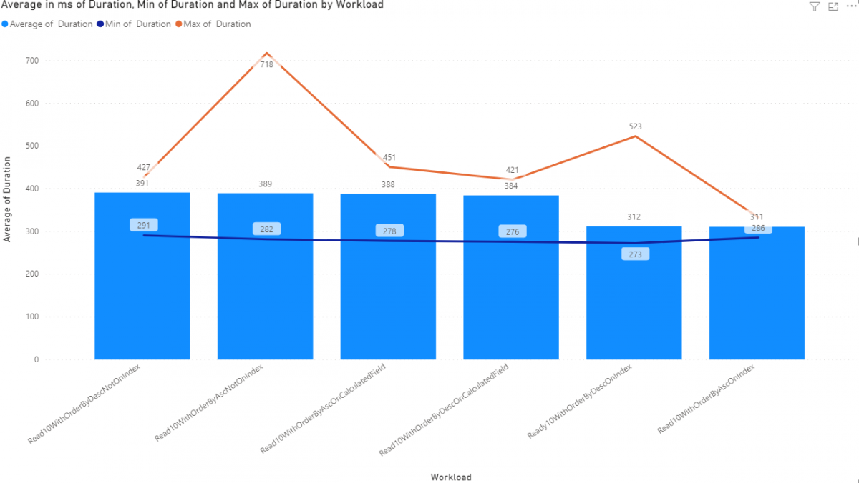
Notes:
Dev VM
Read 10 With Order By Descending Not on an Index - We're going to read 10 Sales Order Headers with an order by clause in the OData query with the order by descending specifically not being used on a field in an index
Read 10 with Order By Ascending Not on an Index - Same as the previous test but with an order by ascending
Read 10 with Order by Ascending On a calculated field - Same as the previous test but with an order by ascending
Read 10 with Order By Descending On a calculated field - We're going to read 10 Sales Order Headers with an order by clause in the OData query with an order by descending on a calculated field. Calculated fields are SQL Sub-selects in the view so they cannot be part of an index by definition
Read 10 With Order By Descending On an Index - We're going to read 10 Sales Order Headers with an order by clause in the OData query with an order by descending on a field specifically selected as being part of an index.
Read 10 With Order By Ascending on an Index - Same as the previous test but with an order by ascending

Slide 31
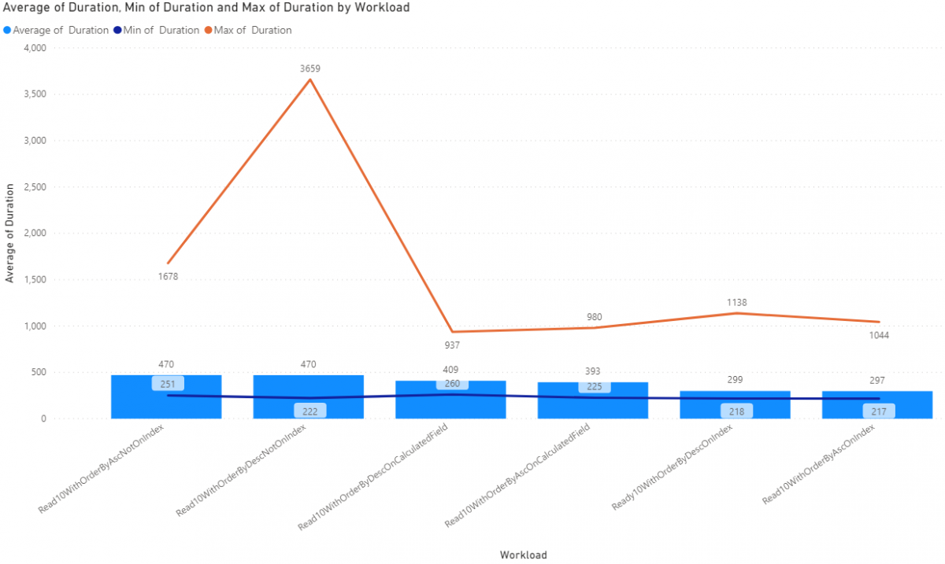
Notes:
UAT
Increased variability, network traffic included in metrics
Order by on indexes still the fastest

Slide 32

Read Performance – Multi-threading
More work means longer working times
Largely a CPU constrained throughput problem
More CPU means more speed
Request processing times scale linearly with thread count
Development, UAT and PROD could and/or will act differently
Don't do this

Slide 33
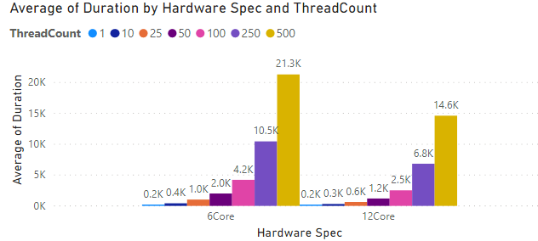

Slide 34
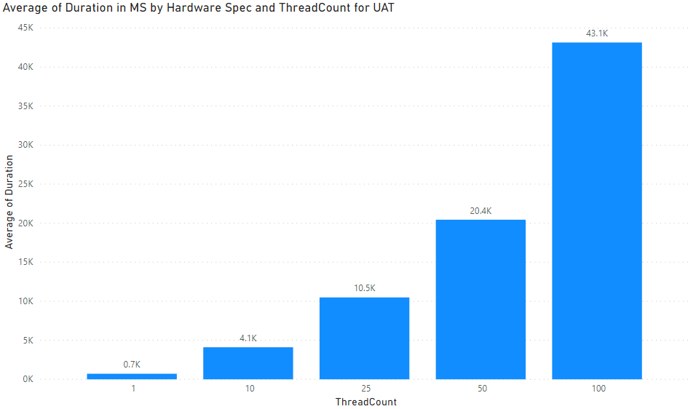
Notes:
UAT
250 and 500 thread count tests failed, started getting 500 errors from server
Throttled differently than dev so something to keep in mind

Slide 35

Read performance – EXPAND()
Slower on T1 compared to doing 2 requests
Faster T2+ compared to doing 2 requests

Slide 36
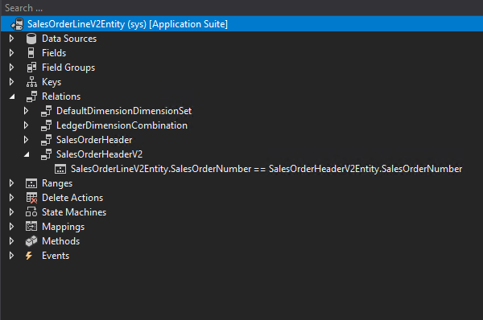

Slide 37
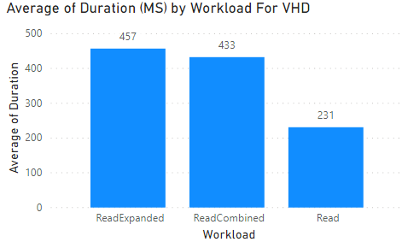

Slide 38
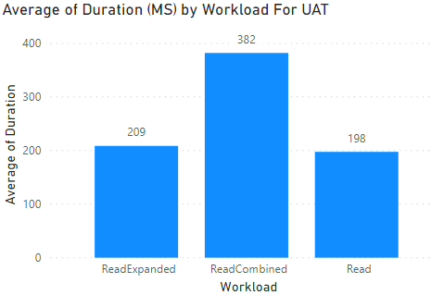

Slide 39

Read Performance - Simplicity
May have to copy/paste OOTB entities and remove features for performance
“Chop Out” what you don’t need
Build your own based on needs
Must reconcile changes with each release
Complete control

Slide 40
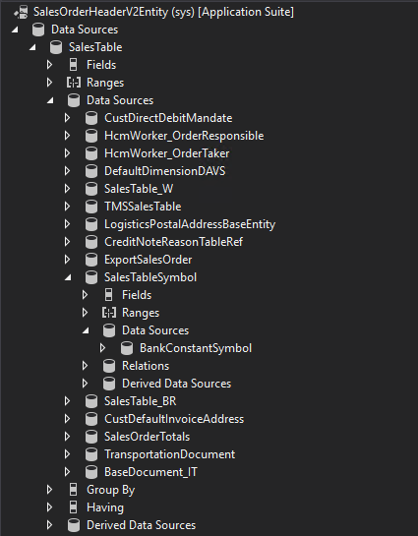
Notes:
Pink arrows are localizations
Blue are entities or views that cause slowness
Purple is related to specific functionality that may not be used

Slide 41
Insert Performance – “Compound” Entities
Have lots of data sources
Lots of code
Performance scales to amount of data being persisted.
A few fields only is fast
Adding more fields increases time to persist
Saving data in many fields also increases time to persist

Slide 42
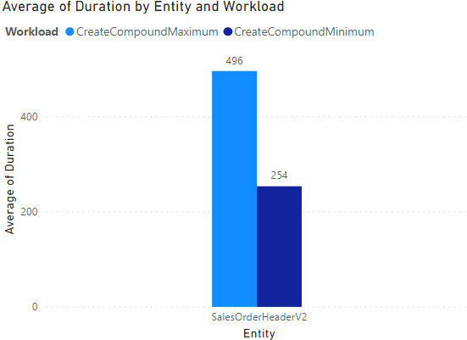
Development / T1
Notes:
DEV

Slide 43
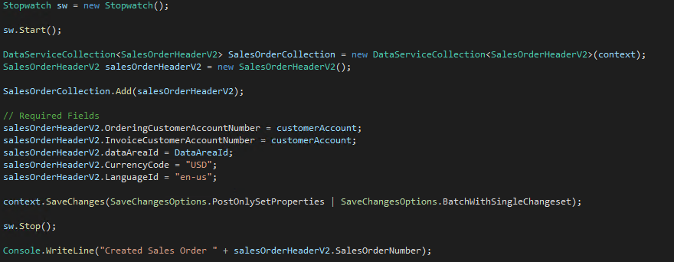
“Minimum”

Slide 44
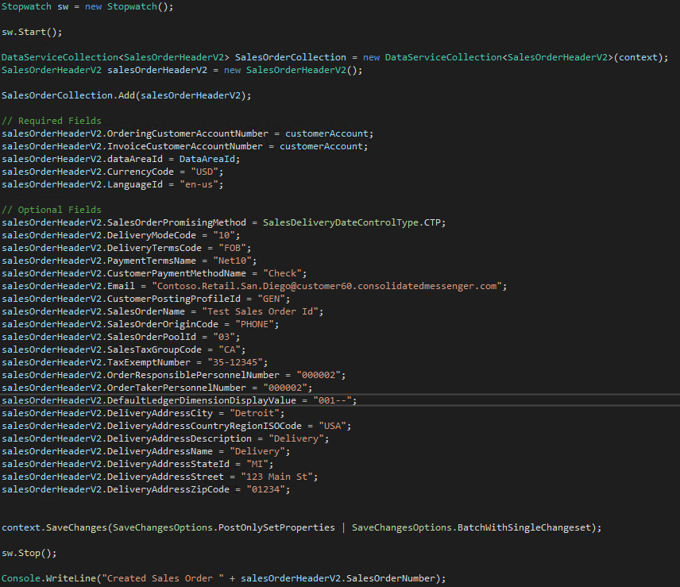
“Maximum”

Slide 45
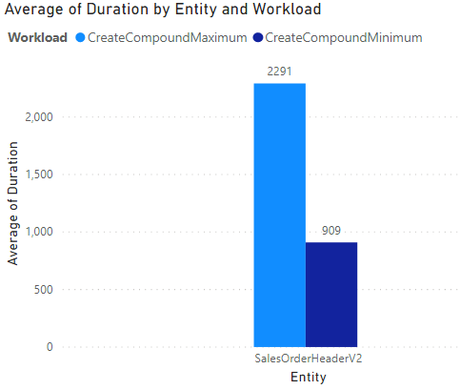
UAT / T2
Notes:
UAT

Slide 46

Insert Performance – “Simple” Entities
Simple entities
Have only 1 or 2 tables (minimum of what is required for the specific requirement)
Can handle very little code, only what is required to fill the need
Again, Performance scales to amount of data being persisted.

Slide 47
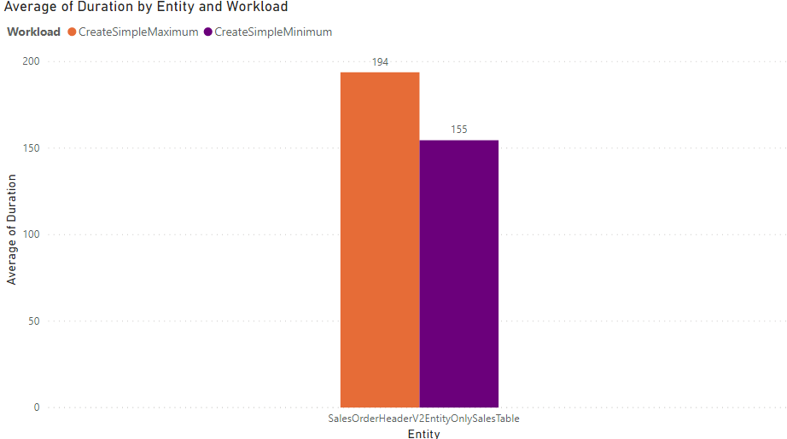

Slide 48
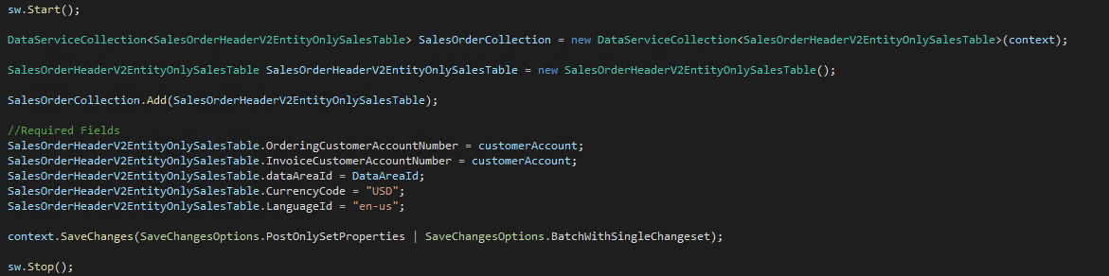
“Minimum” insert with simple entity

Slide 49
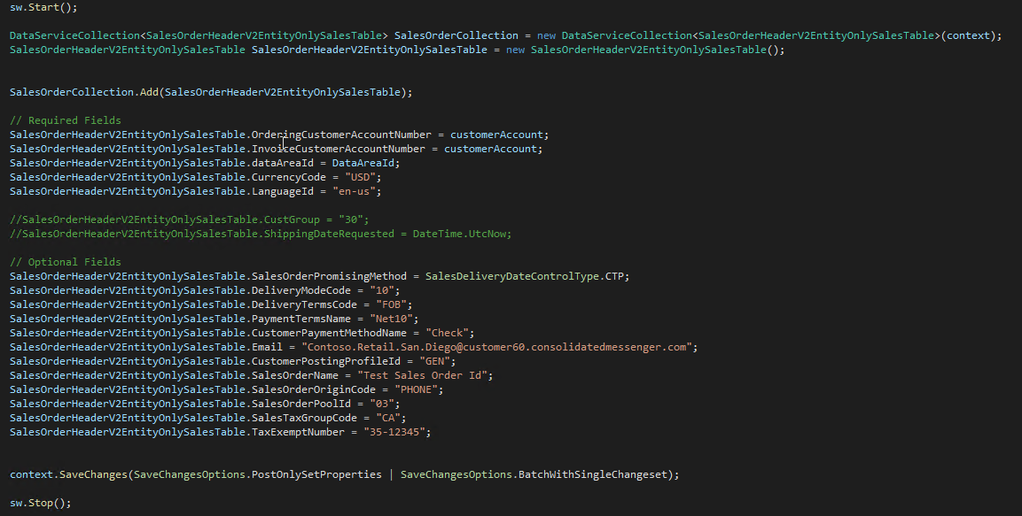
“Maximum” insert with simple entity
Notes:
Entity in an entity encapsulated functionality and concepts well
But slow, MSFT support not a fan of this in customizations

Slide 51

Update Performance
Same as insert performance
Updating fewer fields is faster than updating lots of fields
Business logic in classes/tables will always execute
“Simplicity” doesn’t quite scale as well

Slide 52
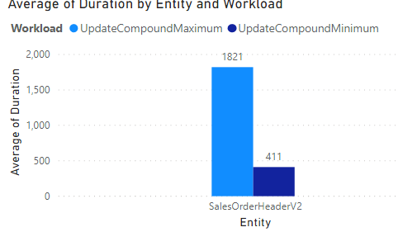
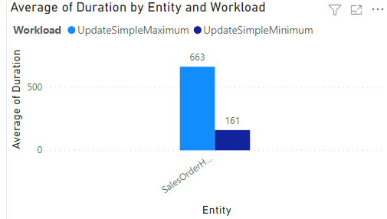
Compound
Simple
Notes:
Minimum is updating 1 text field with no validation
Maximum is updating 5 text fields with no validation

Slide 53

Delete Performance
Similar to insert performance
Unique Case
Only need to know the key to delete it
Scope on primary key
Then delete
Is it faster?
Can I Switch entities?
“simple” is faster than compound
“single” is the fastest

Slide 54
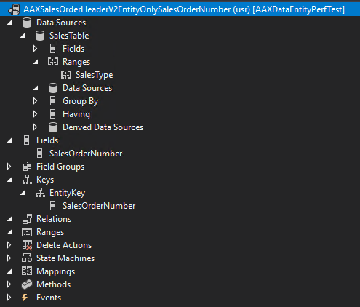

Slide 55
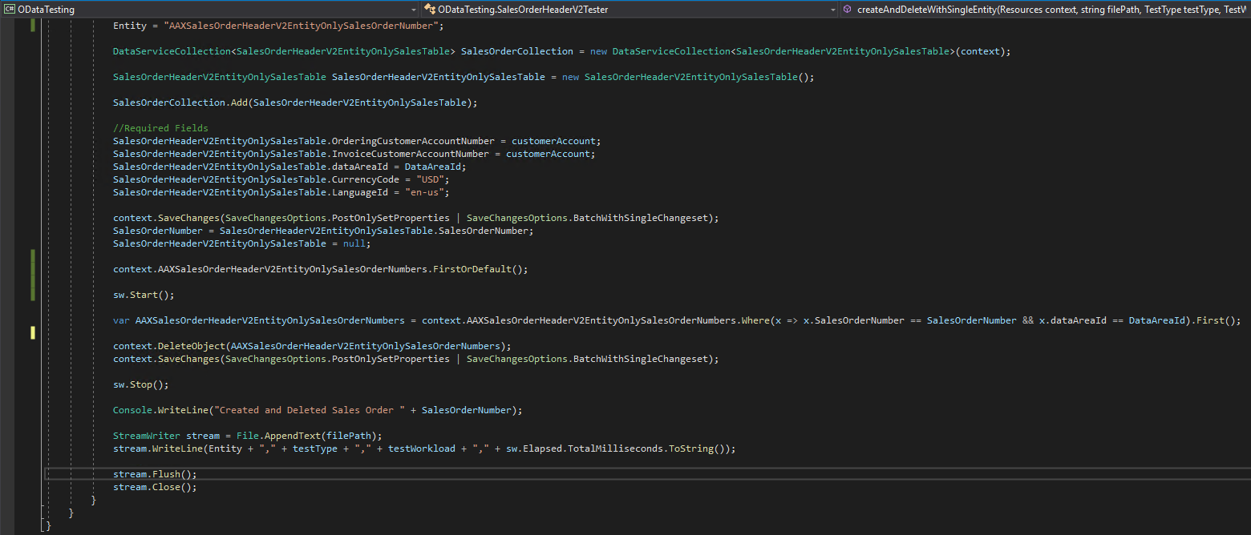

Slide 56
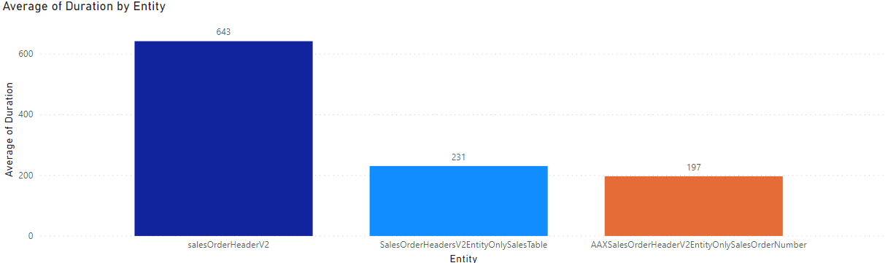
Delete Performance By Entity Type

Slide 57
Recap
Read Workloads
Fewer columns is better
Fewer joins is better
ReadOnly attribute is for functionality
Avoid sub-selects
Use SELECT() to reduce network lag for sets
Filter based on indexes
Limit use of ORDERBY(); sort after you get data
Use ORDERBY() on an index when used
Use EXPAND() when it makes sense
Don’t Multi-thread OData calls
Insert and Update
Fewer columns is better
Fewer joins is better
Fewer fields specified in operation is better
Create “Simple” entities, if applicable
Delete
Use “Single” entity for best performance
Build
Measure
Learn

Slide 58

Questions?

Slide 59
Nathan Clouse
Microsoft Business Applications MVP
Technical Architect enVista Corp.
Microsoft Business Applications MVP nclouse@envistacorp.com www.atomicax.com
@NathanClouseAX

